Slide 1

UNIT IV
Roshan d suvaris

Slide 2
Express and GraphQL
1. Introduction
React provides the front-end user interface.
Express and Node.js are used to provide the back-end server.
Earlier, the Express server served only static content such as index.html.
Now, the application can:
  Fetch data from the server using APIs.
  Store data through APIs.
  Replace hard-coded data in the browser with server-provided data.
Both front-end and back-end code need to be modified to implement and consume APIs.
Initially, data can be maintained in a simulated database in server memory.

Slide 3
2. Express
What is Express?
Express is a minimal and flexible web application framework for Node.js.
It can do much more than serving static files.
Express itself provides minimal functionality.
It depends on middleware to provide additional functionality required by applications.
Express provides important features such as:
  Routing
  Request handling
  Response handling
  Middleware
  API development

Slide 4
3. Routing in Express
  At the heart of Express is a router, which essentially takes a client request, matches it against any routes that are present, and executes the handler function that is associated with that route. The handler function is expected to generate the appropriate response.
  A route specification contains:
    HTTP method – GET, POST, etc.
    Path specification – URL pattern.
    Route handler – function that processes the request.
  Basic Structure
    app.get('/hello', (req, res) => {
    res.send('Hello World!');
    });
  app.get() → specifies the HTTP method.
  /hello → specifies the URL path.
  (req, res) → request and response objects.
  res.send() → sends the response to the client.

Slide 5
4. Request Matching
    When a request is received, the first thing that Express does is match the request to one of the routes.
    The request method is matched against the route’s method. In the previous example, the route’s method is get() so any HTTP request using the GET method will match it.
    Further, the request URL is matched with the path specification, the first argument in the route, which is /hello. When a HTTP request matches this specification, the handler function is called.
    The route’s method and path need not be specific. If you want to match all HTTP methods, you could write app.all().
    If you needed to match multiple paths, you could pass in an array of paths, or even a regular expression like '/*.do' will match any request ending with the extension .do.
5. Route Parameters
    Route parameters are named segments in a URL path that represent dynamic values.
      app.get('/customers/:customerId', ...);
    Here customerId is route parameter
    The URL /customers/1234 will match the route specification, and so will /customers/4567. In either case, the customer ID will be captured and supplied to the handler function as part of the request in req. params, with the name of the parameter as the key.
    Example
    app.get('/customers/:customerId', (req, res) => {
    res.send(req.params.customerId);
    });

Slide 6
6. Route Lookup
  Express can have multiple routes.
  Routes are checked in the order in which they are defined.
  Express does not search for the "best" matching route.
  The first matching route is used.
  More specific routes should be placed before generic routes.
  Example:
  /api/issues
  should be defined before a generic route such as:
  /api/*
  This prevents the generic route from handling a request that should have been handled by a specific route.

Slide 7
Handler Function
  Once a route is matched, the handler function is called, which in the previous example was an anonymous function supplied to the route setup function.
  The parameters passed to the handler are a request object and a response object. The handler function is not expected to return any value.
  But it can inspect the request object and send out a response as part of the response object based on the request parameters.
  Request Object
  Used to inspect information about the incoming request.
  Response Object
  Used to construct and send the response.

Slide 8
Request Object
  Any aspect of the request can be inspected using the request object’s properties and methods. A few important and useful properties and methods are listed here:
    req.params: This is an object containing properties mapped to the named route parameters as you saw in the example that used :customerId. The property’s key will be the name of the route parameter (customerId in this case) and the value will be the actual string sent as part of the HTTP request.
    req.query: This holds a parsed query string. It’s an object with keys as the query string parameters and values as the query string values.
      Example: /issues?status=closed
      Multiple keys with the same name are converted to arrays, and keys with a square bracket notation result in nested objects (e.g., order[status]=closed can be accessed as req.query.order. status).
    req.header, req.get(header): The get method gives access to any header in the request. The header property is an object with all headers stored as key-value pairs.
      Example: req.get('Accept')
    req.path: This contains the path part of the URL, that is, everything up to any ? that starts the query string. Usually, the path is part of the route specification, but if the path is a pattern that can match different URLs, you can use this property to get the actual path that was received in the request.
      Example: /issues?status=closed
      The path is: /issues

Slide 9
  req.url, req.originalURL: These properties contain the complete URL, including the query string. Note that if you have any middleware that modifies the request URL, originalURL will hold the URL as it was received, before the modification.
    Example: /issues?status=closed
  req.body: This contains the body of the request, valid for POST, PUT, and PATCH requests. Note that the body is not available (req.body will be undefined) unless a middleware is installed to read and optionally interpret or parse the body.

Slide 10
Express Response Object
  The response object is used to construct and send a response. Note that if no response is sent, the client is left waiting.
    res.send(body): Used to send a response to the client. Objects and arrays are automatically converted to JSON.
    res.send('Hello World!’);
    res.status(code): This sets the response status code. If not set, it is defaulted to 200 OK. One common way of sending an error is by combining the status() and send() methods in a single call like res.status(403).send("Access Denied").
      Example: res.status(403).send('Access Denied');
    res.json(object): This is the same as res.send(), except that this method forces conversion of the parameter passed into a JSON, whereas res.send() may treat some parameters like null differently. It also makes the code readable and explicit, stating that you are indeed sending out a JSON.
      Example:
      res.json({
      name: 'Roshan',
      course: 'MCA'
      });
    res.sendFile(path): This responds with the contents of the file at path. The content type of the response is guessed using the extension of the file.
    Example : res.sendFile('/path/to/index.html');

Slide 11
Middleware
  Express is a web framework that has minimal functionality of its own. An Express application is essentially a series of middleware function calls.
  In fact, the Router itself is nothing but a middleware function.
  The distinction is that middleware usually works on generic handling of requests and/or things that need to be done for all or most requests, but not necessarily be the last in the chain, that sends out a response.
  A route, on the other hand, is meant to be used for a specific path+method combination and is expected to send out a response.
  Middleware functions are those that have access to the request object (req), the response object (res), and the next middleware function in the application’s request-response cycle.
  The next middleware function is commonly denoted by a variable named next.
  We used one middleware called express.static in the Hello World example, to serve static files.
  Middleware can be at the application level (applies to all requests) or at a specific path level (applies to specific request path patterns).
  The way to use a middleware at the application level is to simply supply the function to the application, like this:
    app.use(middlewareFunction);
  Middleware can also be applied only to a specific URL path.
    app.use('/public', express.static('public'));

Slide 12
REST API
  REST (Representational State Transfer) is an architectural pattern for application programming interfaces (APIs).
  There are other older patterns such as SOAP and XMLRPC, but of late, the REST pattern has gained popularity.
  Since the APIs in the Issue Tracker application are only for internal consumption, we could use any API pattern or even invent our own.
  REST pattern is one of the more popular choices due to its simplicity and small number of constructs.
  Resource Based
    The APIs are resource-based (as opposed to action-based).
    There are no API names in the conventional sense, because APIs are formed by a combination of resources and actions.
    There are really only resource names called endpoints.
    Resources are accessed based on a Uniform Resource Identifier (URI), also known as an endpoint.
    You typically use two URIs per resource: one for the collection (like /customers) and one for an individual object (like /customers/1234), where 1234 uniquely identifies a customer.

Slide 13
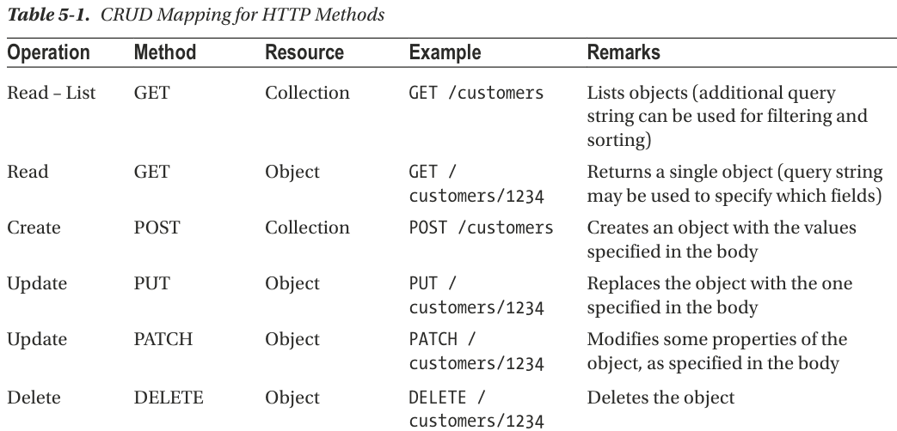
HTTP Methods as Actions
  To access and manipulate resources, you use HTTP methods.
  While resources were nouns, the HTTP methods are verbs that operate on them. They map to CRUD (Create, Read, Update, Delete) operations on the resource.

Slide 14
Some other operations such as DELETE and PUT in the collection may also be used to delete and modify the entire collection in one shot, but this is not common usage.
HEAD and OPTIONS are also valid verbs that give out information about the resources rather than actual data. They are used mainly for APIs that are externally exposed and consumed by many different clients.
HTTP method and operation mapping are well mapped and specified, REST by itself lays down no rules for the following:
  • Filtering, sorting, and paginating a list of objects. The query string is commonly used in an implementation-specific way to specify these.
  • Specifying which fields to return in a READ operation.
  • If there are embedded objects, specifying which of those to expand in a READ operation.
  • Specifying which fields to modify in a PATCH operation.
  • Representation of objects. You are free to use JSON, XML, or any other representation for the objects in both READ and WRITE operations.

Slide 15
GraphQL
  Although the REST paradigm is quite useful in making APIs predictable, the shortcomings discussed previously have made it hard to use it when different clients access the same set of APIs.
  For example, how an object is displayed in a mobile application and the same is displayed in a desktop browser can be quite different

Slide 16
GraphQL is a far more elaborate specification, with the following salient features.
  Field Specification
    Unlike REST APIs, where you have little control on what the server returns as part of an object, in GraphQL, the properties of an object that need to be returned must be specified.
    Specifying no fields of an object would, in a REST API, return the entire object. In contrast, in a GraphQL query, it is invalid to request nothing.
    This lets the client control the amount of data that is transferred over the network, making it more efficient, especially for lighter front-ends such as mobile applications.
  Graph Based
    REST APIs were resource based, whereas GraphQL is graph based. This means that relationships between objects are naturally handled in GraphQL APIs.
  Single Endpoint
    GraphQL API servers have a single endpoint in contrast to one endpoint per resource in REST.
    The name of the resource(s) or field(s) being accessed is supplied as part of the query itself.
    This makes it possible to use a single query for all the data that is required by a client.
    Due to the graph-based nature of the query, all related objects can be retrieved as part of a query for one object.
    Not only that, even unrelated objects can be queried in a single call to the API server.

Slide 17
Strongly Typed
  GraphQL is a strongly typed query language.
  All fields and arguments have a type against which both queries and results can be validated and give descriptive error messages.
  In addition to types, it is also possible to specify which fields and arguments are required and which others are optional. All this is done using the GraphQL schema language.
  The advantage of a strongly typed system is that it prevents errors.
Introspection
  A GraphQL server can be queried for the types it supports.
  This creates a powerful platform for tools and client software to build atop this information.
  This includes code-generation utilities in statically typed languages and explorers that let developers test and learn an API set quickly, without grepping the codebase or wrangling with cURL.
Libraries
  Parsing and dealing with the type system language (also called the GraphQL Schema Language) as well as the query language is hard to do on your own.
  Fortunately, there are tools and libraries available in most languages for this purpose.
  For JavaScript on the back-end, there is a reference implementation of GraphQL called GraphQL.js.
  To tie this to Express and enable HTTP requests to be the transport mechanism for the API calls, there is a package called express-graphql.

Slide 18
REST API and GraphQL
REST API and GraphQL are two approaches used by client applications to communicate with a server and exchange data.
  REST API: Uses multiple endpoints to access different resources.
  GraphQL: Uses a query language that allows the client to request specific data, commonly through a single endpoint.

Slide 19
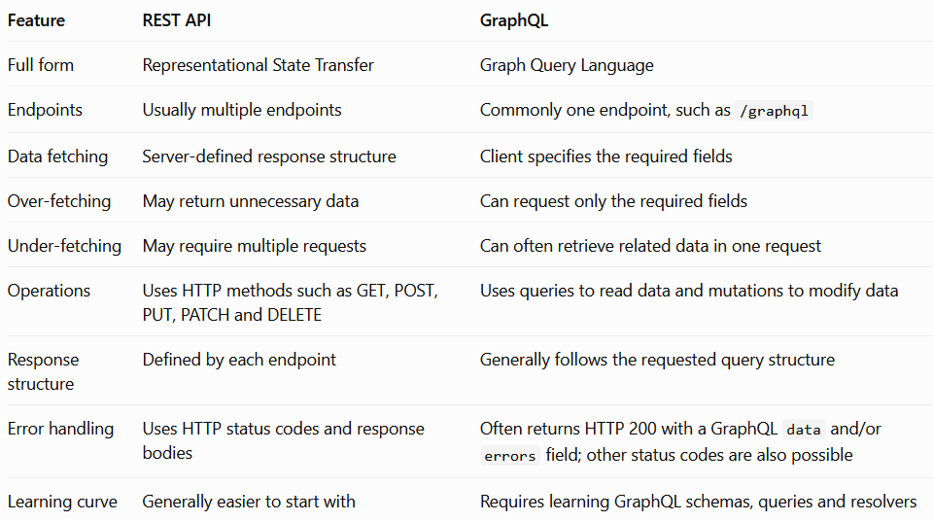
x

Slide 20
The List API
  GraphQL Issue Tracker
    Implement an API to fetch a list of issues.
    Define the GraphQL Issue type.
    Add an issueList field to the Query.
    Create a resolver for issueList.
    Test the API using GraphQL Playground.
  Objective of the List API
    The next step in the Issue Tracker application is to implement an API for fetching issues.
    The API will return a list of issues.
    The API will first be tested using GraphQL Playground.
    Later, the front-end will be modified to use this API.

Slide 21
The next thing we’ll do is implement an API to fetch a list of issues.
Let’s start by modifying the schema to define a custom type called Issue. It should contain all the fields of the issue object
But since there is no scalar type to denote a date in GraphQL, let’s use a string type for the time being.
So, the type will have integers and strings, some of which are optional. Here’s the partial schema code for the new type:
    ...
    type Issue {
    id: Int!
    ...
    due: String
    }
    ...

Slide 22
Continued…
  let’s add a new field under Query to return a list of issues.
  The GraphQL way to specify a list of another type is to enclose it within square brackets.
  We could use [Issue] as the type for the field, which we will call issueList.
  But we need to say not only that the return value is mandatory, but also that each element in the list cannot be null.
  So, we have to add the exclamation mark after Issue as well as after the array type, as in [Issue!]!.
  The way to add comments in the schema is using the # character at the beginning of a line.
        type Issue {
        id: Int!
        title: String!
        status: String!
        owner: String
        effort: Int
        created: String!
        due: String
        }
        ##### Top level declarations
        type Query {
        about: String!
        issueList: [Issue!]!
        }
        type Mutation {
        setAboutMessage(message: String!): String
        }

Slide 23
  In the server code, we need to add a resolver under Query for the new field, which points to a function.
  We’ll also have an array of issues (a copy of what we have in the front-end code) that is a stand-in for a database.
  We can immediately return this array from the resolver.
  The function could be in-place like that for the about field, but knowing that we’ll expand this function to do more than just return a hard-coded array,
  let’s create a separate function called issueList for it.
  server.js: Changes for issueList Query Field
  ...
  let aboutMessage = "Issue Tracker API v1.0";
  const issuesDB = [
  {
  id: 1, status: 'New', owner: 'Ravan', effort: 5,
  created: new Date('2019-01-15'), due: undefined,
  title: 'Error in console when clicking Add’,
  },
  {
  id: 2, status: 'Assigned', owner: 'Eddie', effort: 14,
  created: new Date('2019-01-16'), due: new Date('2019-02-01’),
  title: 'Missing bottom border on panel’,
  },
  ];
  const resolvers = {
  Query: {
  about: () => aboutMessage,
  issueList,
  },
  Mutation: {
  setAboutMessage,
  },
  };
  function setAboutMessage(_, { message }) {
  return aboutMessage = message;
  }
  function issueList() {
  return issuesDB;
  }
  ...

Slide 24
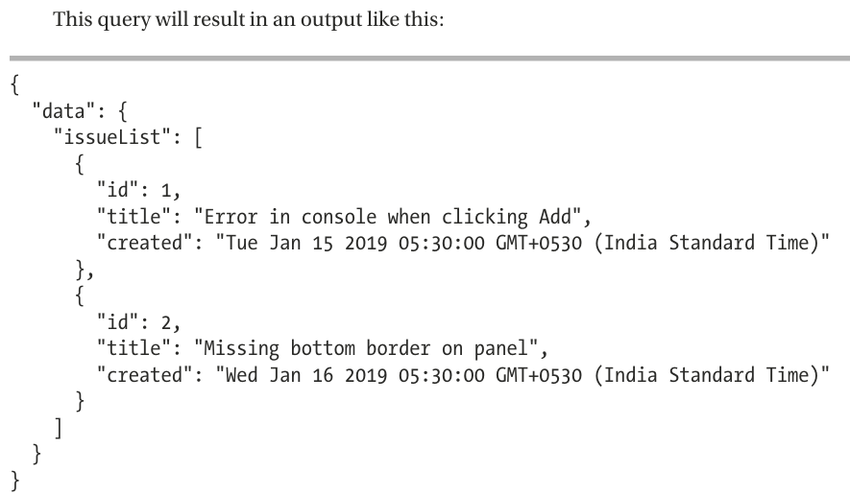
  To test this in the Playground, you will need to run a query that specifies the issueList field, with subfields.
  But first, a refresh of the browser is needed so that the Playground has the latest schema and doesn’t show errors when you type the query.
  The array itself need not be expanded in the query.
  It is implicit (due to the schema specification) that issueList returns an array, and therefore, subfields of the field are automatically expanded within the array.
  Here is one such query that you can run to test the issueList field:
      query {
      issueList {
      id
      title
      created
      }
      }

Slide 25
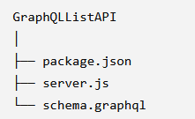
Full program and Execution using LIST API
  Folder structure
  1. Create a file named: package.json with the following content
      {
      "name": "graphql-list-api",
      "version": "1.0.0",
      "description": "GraphQL Issue Tracker List API",
      "main": "server.js",
      "scripts": {
      "start": "node server.js"
      },
      "dependencies": {
      "express": "^4.18.2",
      "express-graphql": "^0.12.0",
      "graphql": "^15.8.0"
      }
      }

Slide 26
2. Create schema.graphql
    type Issue {
    id: Int!
    title: String!
    status: String!
    owner: String
    effort: Int
    created: String!
    due: String
    }
    type Query {
    about: String!
    issueList: [Issue!]!
    }
    type Mutation {
    setAboutMessage(message: String!): String
    }

Slide 27
3. server.js
  const express = require('express');
  const { graphqlHTTP } = require('express-graphql');
  const { buildSchema } = require('graphql');
  const fs = require('fs');
  // Create Express application
  const app = express();
  // Read GraphQL schema
  const schemaText = fs.readFileSync(
  'schema.graphql',
  'utf8'
  );
  // Build GraphQL schema
  const schema = buildSchema(schemaText);
  // About message
  let aboutMessage = 'Issue Tracker API v1.0';
  // Temporary database
  const issuesDB = [
  {
  id: 1,
  status: 'New',
  owner: 'Ravan',
  effort: 5,
  created: new Date('2019-01-15'),
  due: undefined,
  title: 'Error in console when clicking Add'
  },
  {
  id: 2,
  status: 'Assigned',
  owner: 'Eddie',
  effort: 14,
  created: new Date('2019-01-16'),
  due: new Date('2019-02-01'),
  title: 'Missing bottom border on panel'
  }
  ];
  // Resolver functions
  const root = {
  // Query: about
  about: function () {
  return aboutMessage;
  },
  // Query: issueList
  issueList: function () {
  return issuesDB;
  },
  // Mutation: setAboutMessage
  setAboutMessage: function ({ message }) {
  aboutMessage = message;
  return aboutMessage;
  }
  };
  // GraphQL endpoint
  app.use(
  '/graphql',
  graphqlHTTP({
  schema: schema,
  rootValue: root,
  graphiql: true
  })
  );
  // Start server
  const PORT = 3000;
  app.listen(PORT, function () {
  console.log(
  `GraphQL server running at http://localhost:${PORT}/graphql`
  );
  });

Slide 28
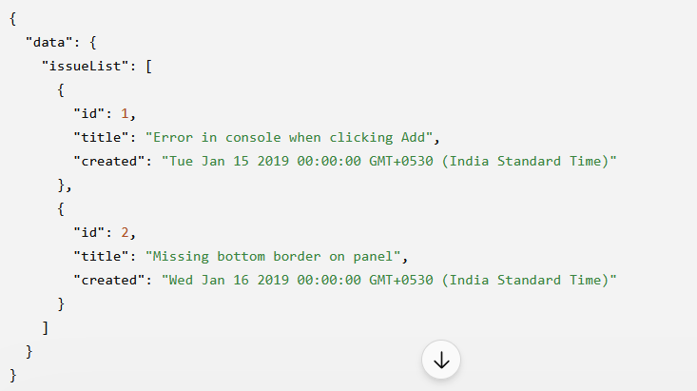
Install the packages
  E:\ReactFolder\GraphQLListAPI
  npm install
  You should get: GraphQL server running at http://localhost:3000/graphql - server is running
  Open GraphQL interface –
    Open your browser and enter: http://localhost:3000/graphql
  You should see the GraphQL interface.
  Enter this query: Output:
      query {
      issueList {
      id
      title
      created
      }
      }
  User can enter any query

Slide 29
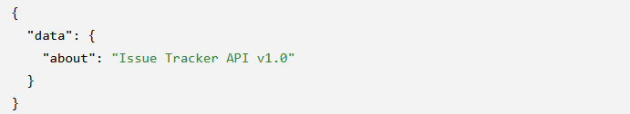
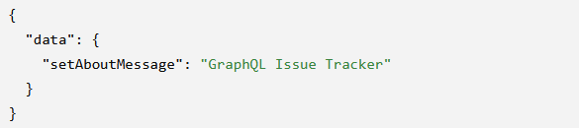
Execute about and mutation functions in GraphQL interface GraphQL interface
    query {
    about
    }
    mutation {
    setAboutMessage(message: "GraphQL Issue Tracker")
    }

Slide 30
The Create API
  API for creating a new issue in the server, which will be appended to the list of issues in the server’s memory.
  we have to first define a field in the schema under Mutation called issueAdd.
  This field should take arguments, just as the setAboutMessage field did. But this time, we need multiple arguments, one for each property of the issue being added.
  Alternatively, we can define a new type as an object that has the fields we need for the input.
  This can’t be the same as the Issue type because it has some required fields (id and created) that are not part of the input.
  These are values that are set by the server only.
  Further, GraphQL needs a different specification when it comes to input types. Instead of using the type keyword, we have to use the input keyword.
  Let’s first define this new input type called IssueInputs in the schema:
    ...
    input IssueInputs {
    # ... fields of Issue
    }
    ...

Slide 31
  We discussed how to add comments in the schema.
  But these comments are not formal descriptions of the types or subfields.
  For real documentation that is shown part of the schema explorer, a string above the field needs to be added.
    ...
    "Toned down Issue, used as inputs, without server generated values.“ - these are comments
    input IssueInputs {
    ...
    "Optional, if not supplied, will be set to 'New’”
    status: String
    ...
    }
    ...

Slide 32
  Now, we can use the type IssueInputs as the argument type to the new issueAdd field under Mutation.
  The return value of this field can be anything. It is usually good practice to return the values generated at the server, typically the ID of the new object. In this case, since both the ID and the created date are set at the server, let’s return the entire issue object that was created.
  schema.graphql: Changes for New Type IssueInputs and New Field issueAdd
      ...
      "Toned down Issue, used as inputs, without server generated values."
      input IssueInputs {
      title: String!
      "Optional, if not supplied, will be set to 'New’”
      status: String
      owner: String
      effort: Int
      due: GraphQLDate
      }
      ##### Top level declarations
      ...
      type Mutation {
      setAboutMessage(message: String!): String
      issueAdd(issue: IssueInputs!): Issue!
      }

Slide 33
  Next, we need a resolver for issueAdd that takes in an IssueInput type and creates a new issue in the in-memory database.
  Just like we did for setAboutMessage, we can ignore the first argument and use a destructuring assignment to access the issue object, which is the input:
      ...
      function issueAdd(_, { issue }) {
      ...
      }
  In the function, let’s set the ID and the created date as we did in the browser:
      …
      issue.created = new Date();
      issue.id = issuesDB.length + 1;
      ...
  Further, let’s also default the status, if not supplied (since we have not declared it as a required subfield) to the value 'New’:
      ...
      if (issue.status == undefined) issue.status = 'New';
      ...

Slide 34
  Finally, we can append the issue to the global variable issuesDB and return the issue object as is:
      ...
        issuesDB.push(issue);
        return issue;
      ...
  This function now can be set as the resolver for the issueAdd field under Mutation:
      ...
        Mutation: {
        setAboutMessage,
        issueAdd,
        },
      ...

Slide 35
  since the type IssueInputs does have a GraphQLDate type, we must implement the parsers for receiving date values. There are two methods that need to be implemented in the GraphQLDate resolver: parseValue and parseLiteral.
  The method parseLiteral is called in the normal case, where the field is specified in-place in the query.
    ...
      parseLiteral(ast) {
      return (ast.kind == Kind.STRING) ? new Date(ast.value) : undefined;
    }, ...
  The method parseValue will be called if the input is supplied as a variable.
    ...
    parseValue(value) {
    return new Date(value);
    },
    ...

Slide 36
  The complete set of changes to server.js is
  ...
  const { GraphQLScalarType } = require('graphql');
  const { Kind } = require('graphql/language');
  ...
  const GraphQLDate = new GraphQLScalarType({
  ...
  parseValue(value) {
  return new Date(value);
  },
  parseLiteral(ast) {
  return (ast.kind == Kind.STRING) ? new Date(ast.value) : undefined;
  },
  });
  ...
  const resolvers = {
  ...
  Mutation: {
  setAboutMessage,
  issueAdd,
  },
  GraphQLDate,
  };
  ...
  function issueAdd(_, { issue }) {
  issue.created = new Date();
  issue.id = issuesDB.length + 1;
  if (issue.status == undefined) issue.status = 'New’;
  issuesDB.push(issue);
  return issue;
  }
  ...

Slide 37
Full program and Execution using create API
  schema.graphql
    scalar GraphQLDate
    type Issue {
    id: Int!
    title: String!
    status: String!
    owner: String
    effort: Int
    created: GraphQLDate!
    due: GraphQLDate
    }
    "Toned down Issue, used as inputs, without server generated values."
    input IssueInputs {
    title: String!
    "Optional, if not supplied, will be set to 'New'"
    status: String
    owner: String
    effort: Int
    due: GraphQLDate
    }
    type Query {
    about: String!
    issueList: [Issue!]!
    }
    type Mutation {
    setAboutMessage(message: String!): String
    issueAdd(issue: IssueInputs!): Issue!
    }

Slide 38
  server.js
    const express = require('express');
    const { graphqlHTTP } = require('express-graphql');
    const {
    buildSchema,
    GraphQLScalarType,
    Kind
    } = require('graphql');
    const fs = require('fs');
    const app = express();
    // Read GraphQL schema from schema.graphql
    const schemaText = fs.readFileSync('schema.graphql', 'utf8');
    const schema = buildSchema(schemaText);
    let aboutMessage = 'Issue Tracker API v1.0';
    const issuesDB = [
    {
    id: 1,
    status: 'New',
    owner: 'Ravan',
    effort: 5,
    created: new Date('2019-01-15'),
    due: undefined,
    title: 'Error in console when clicking Add'
    },
    {
    id: 2,
    status: 'Assigned',
    owner: 'Eddie',
    effort: 14,
    created: new Date('2019-01-16'),
    due: new Date('2019-02-01'),
    title: 'Missing bottom border on panel'
    }
    ];

Slide 39
continued…
    // Custom GraphQL Date scalar
    const GraphQLDate = new GraphQLScalarType({
    name: 'GraphQLDate',
    description: 'Custom scalar type for dates',
    parseValue(value) {
    return new Date(value);
    },
    parseLiteral(ast) {
    if (ast.kind === Kind.STRING) {
    return new Date(ast.value);
    }
    return undefined;
    },
    serialize(value) {
    return new Date(value).toISOString();
    }
    });
    // Query resolvers
    function about() {
    return aboutMessage;
    }
    function issueList() {
    return issuesDB;
    }
    // Mutation resolver
    function setAboutMessage(_, { message }) {
    aboutMessage = message;
    return aboutMessage;
    }
    // Create API
    function issueAdd(_, { issue }) {
    issue.id = issuesDB.length + 1;
    issue.created = new Date();
    if (issue.status === undefined) {
    issue.status = 'New';
    }
    issuesDB.push(issue);
    return issue;
    }

Slide 40
continued…
    // Root resolver
    const root = {
    about,
    issueList,
    setAboutMessage,
    issueAdd,
    GraphQLDate
    };
    // GraphQL middleware
    app.use(
    '/graphql',
    graphqlHTTP({
    schema: schema,
    rootValue: root,
    graphiql: true
    })
    );
    // Start server
    const PORT = 3000;
    app.listen(PORT, function () {
    console.log(
    `GraphQL server running at http://localhost:${PORT}/graphql`
    );
    });

Slide 41
  Displaying Errors
    Purpose: Display error messages to the user.
    Handle different types of errors:
    Transport errors
    Invalid user input
    Server and other errors
    Create a common utility function called graphQLFetch().
    Replace individual fetch() calls with this common function.

Slide 42
The graphQLFetch() Function
  graphQLFetch() handles all GraphQL API calls.
  It is an async function.
  Takes two arguments:
  query
  variables
  Uses fetch() to send the request to /graphql.
  async function graphQLFetch(query, variables = {}) {
  ...
  }
  This avoids repeating the same fetch code in different components.

Slide 43
Handling Transport Errors
  Transport errors occur due to problems such as:
  Server not running
  Network connection failure
  Server unavailable
  fetch() can throw an error.
  Use a try-catch block to handle these errors.
    try {
    const response = await fetch('/graphql', {
    method: 'POST',
    headers: {
    'Content-Type': 'application/json'
    },
    body: JSON.stringify({ query, variables })
    });
    ...
    } catch (e) {
    alert(`Error in sending data to server: ${e.message}`);
    }
  The error is displayed using alert().

Slide 44
Handling GraphQL Errors
  After receiving the response:
  Convert response to text.
  Parse the JSON.
  Check result.errors.
    const body = await response.text();
    const result = JSON.parse(body, jsonDateReviver);
    if (result.errors) {
    const error = result.errors[0];
    ...
    }
  GraphQL errors contain:
    Error message
    Error code
    Additional error details
  Error code is available through:
    error.extensions.code

Slide 45
Handling BAD_USER_INPUT
  BAD_USER_INPUT indicates that the user entered invalid data.
  Validation errors are available in:
    error.extensions.exception.errors
  Multiple validation errors are joined together.
    if (error.extensions.code == 'BAD_USER_INPUT') {
    const details =
    error.extensions.exception.errors.join('\n ');
    alert(`${error.message}:\n ${details}`);
    }
  This gives the user meaningful validation information.

Slide 46
Handling Other Errors
For errors other than BAD_USER_INPUT:
  Display the error code.
  Display the error message.
    else {
    alert(`${error.extensions.code}: ${error.message}`);
    }
  Finally, return the data received from GraphQL.
    return result.data;
  If an error occurs during transport, the function displays the error and does not return data.

Slide 47
Using graphQLFetch() in IssueList
  The existing fetch() code in loadData() can be removed.
  Call the common graphQLFetch() function instead.
    async loadData() {
    const query = `query {
    issueList {
    id
    title
    status
    owner
    effort
    created
    due
    }
    }`;
    const data = await graphQLFetch(query);
    if (data) {
    this.setState({
    issues: data.issueList
    });
    }
    }
  If the API call succeeds, the returned data is used to update the state.
  If an error occurs, graphQLFetch() displays it.

Slide 48
Using graphQLFetch() in Create Issue
  createIssue() also uses the common function.
  Pass both:
    GraphQL query
    Variables containing the issue
    const data = await graphQLFetch(query, { issue });
    if (data) {
    this.loadData();
    }
  Testing Errors
    Transport error: Stop the server and try to add an issue.
    Invalid title: Enter a title that violates the minimum length.
    Other validations can be tested by temporarily changing input values:
      Invalid status
      Invalid due date
      Other validation rules

Slide 49
x

Slide 50
x

Slide 51
x

Slide 52
x

Slide 53
x

Slide 54
x

Slide 55
x

Slide 56
x

Slide 57
x

Slide 58
x

Slide 59
x

Slide 60
x

Slide 61
x

Slide 62
x

Slide 63
x

Slide 64
x

Slide 65
x

Slide 66
x

Slide 67
x

Slide 68
x

Slide 69
x

Slide 70
x

Slide 71
x

Slide 72
x

Slide 73
x

Slide 74
x

Slide 75
x

Slide 76
x

